Slide 1



SRI SIDDHARTHA INSTITUTE OF TECHNOLOGY
(A Constituent College of Sri Siddhartha Academy of Higher Education)
Approved by AICTE, Accredited by NAAC with ‘A’ Grade
MARALUR, TUMAKURU-572105
Department of Computer Science And Engineering(Accredited by NBA)
PROJECT PRESENTATION ON
“WEB BASED PROJECT MANAGEMENT ”
Submitted by:-
Shreyas T M -18CS088
Rakesh Honnamore -18CS071
Vinod S C -18CS114
Sahana B D -18CS079
Under the guidance of :-
Mrs. MADHUMALA G
Associate Professor, CSE Dept.
SSIT , Tumakuru
Date :- 21/07/2022

Slide 2

CONTENTS
Introduction
Project Overview
Sources
Admin Module
Faculty Module
Student Module
Conclusion
Bibliography

Slide 3
WEB BASED PROJECT MANAGEMENT SYSTEM:
Manages and stores project information.
Increases performance, productivity and efficiency.
Can be accessed through any web browser.
Define project goals, tasks.
Implementation, evaluation, maintainence.

Slide 4

Project Overview:
Selection of the project ?
Need of the project ?
Use of the project ?

Slide 5
Sources
The user stories and plans are collected from respective Guide, Project coordinator, HOD, and other faculties.
This helped us to open-up for a new view of the working of the modules.

Slide 6


Slide 7
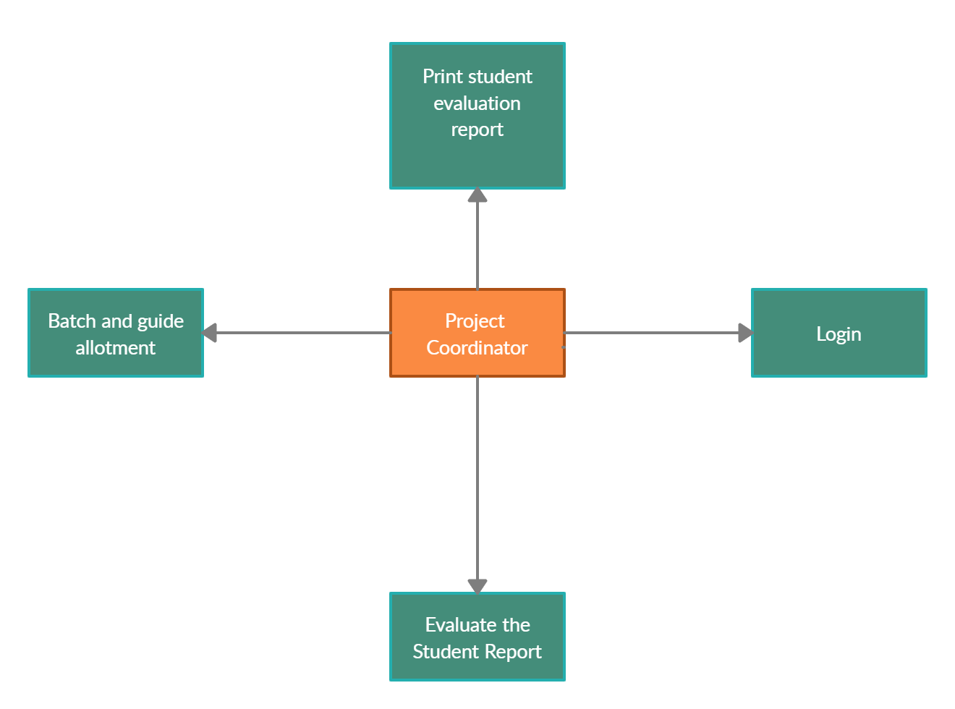
ADMIN MODULE 1. project Coordinator

Slide 8
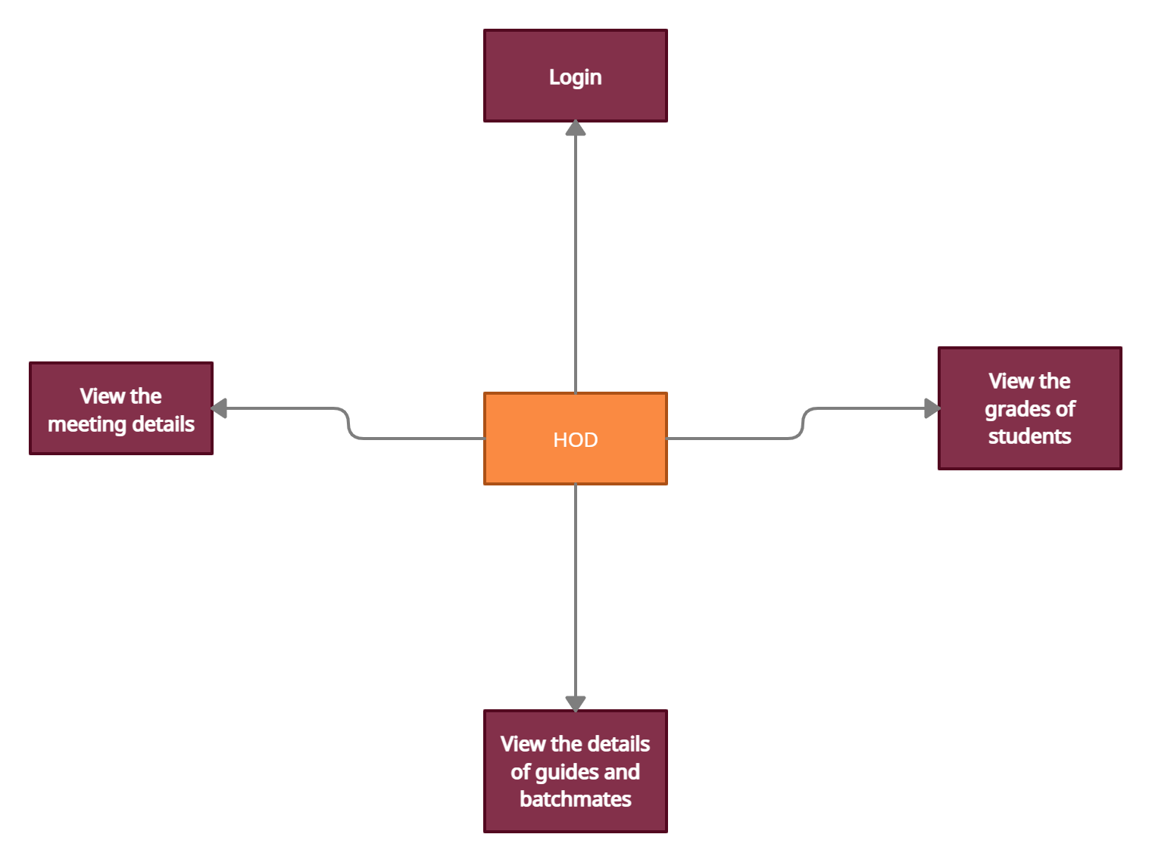
2. HOD

Slide 9
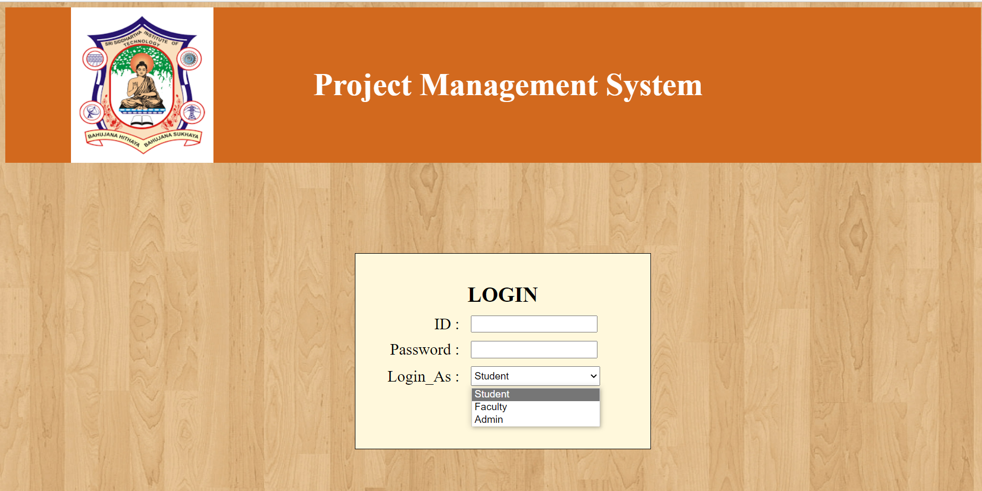
LOGIN PAGE 1.ADMIN 2.FACULTY 3.STUDENT

Slide 10
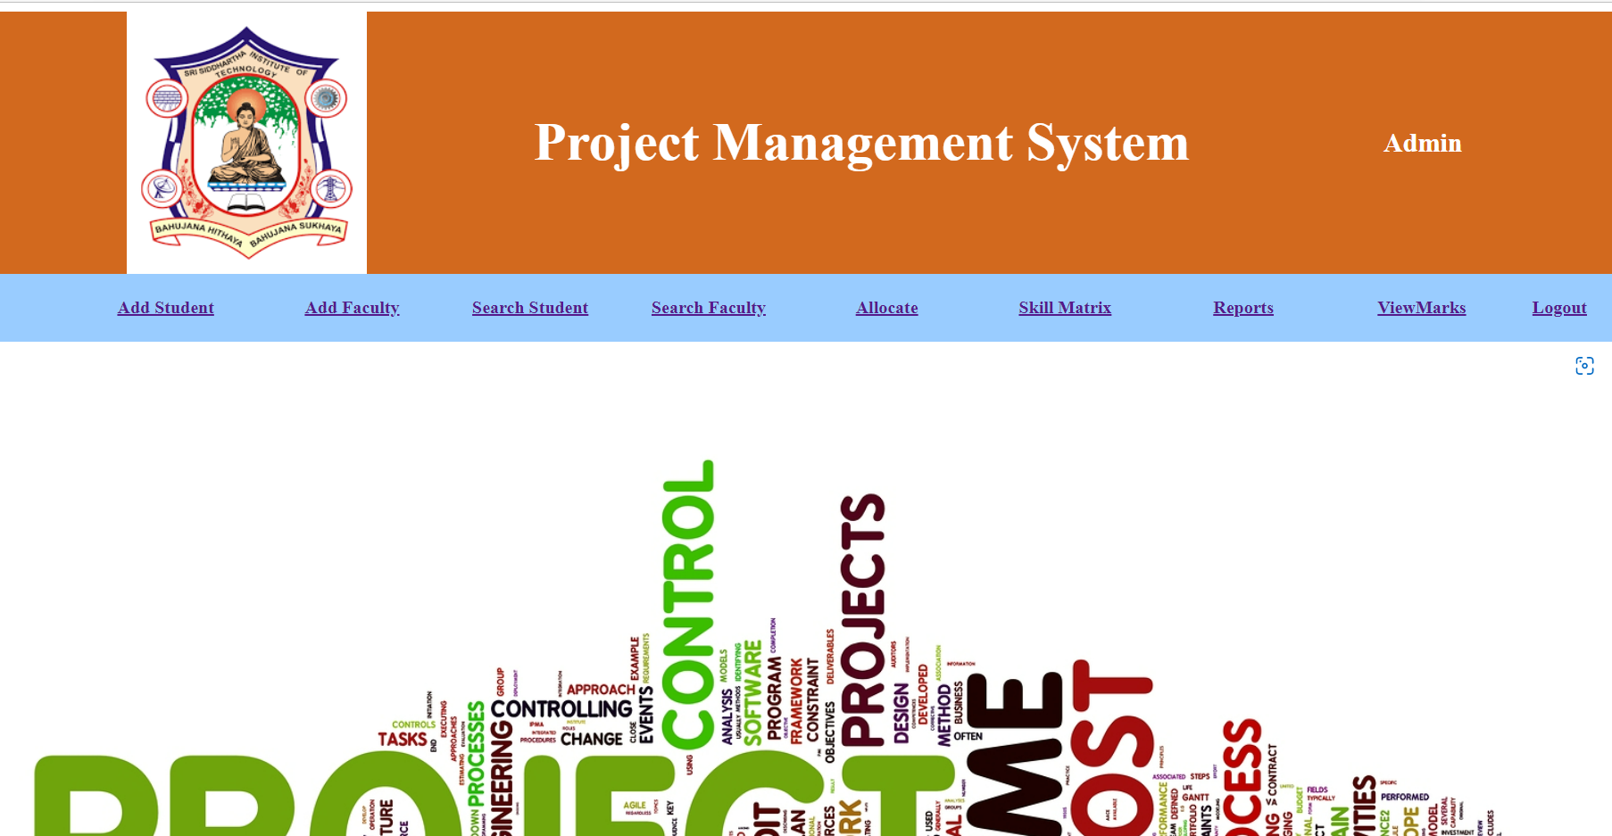
ADMIN WELCOME PAGE

Slide 11
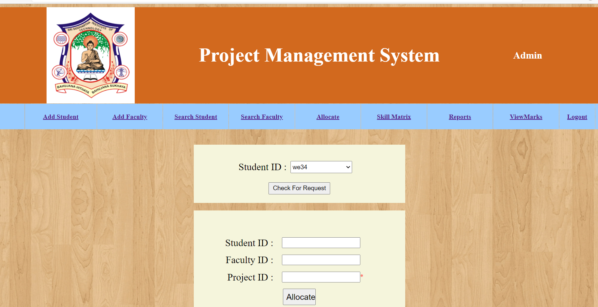
ALLOCATION OF PROJECT

Slide 12
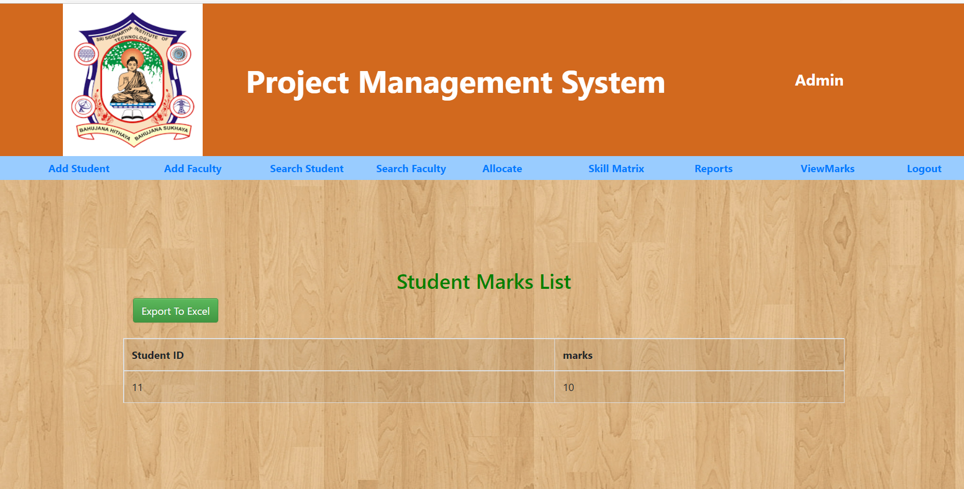
PRINT EVALUTION REPORT

Slide 13
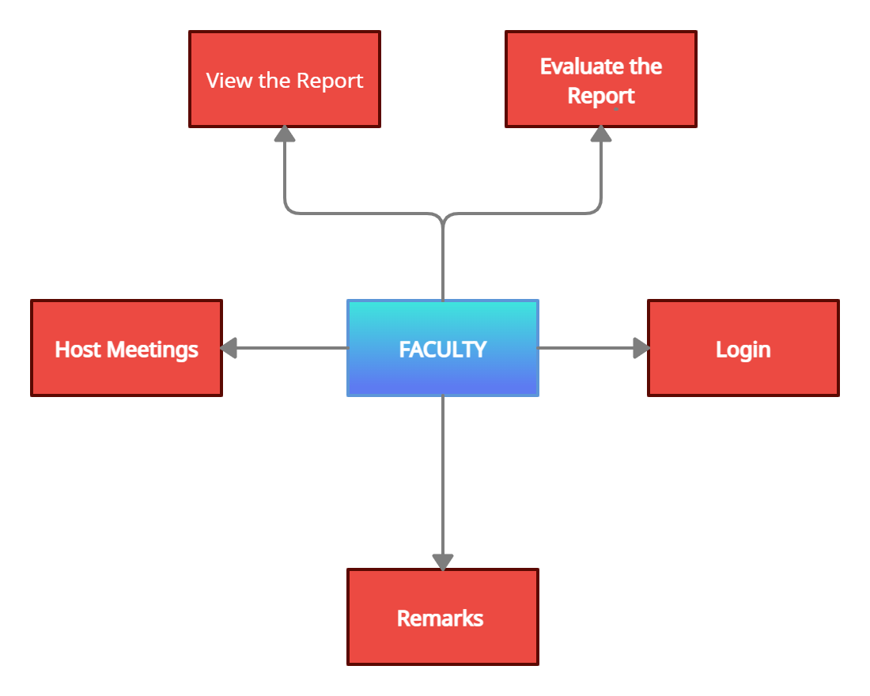
FACULTY MODULE

Slide 14
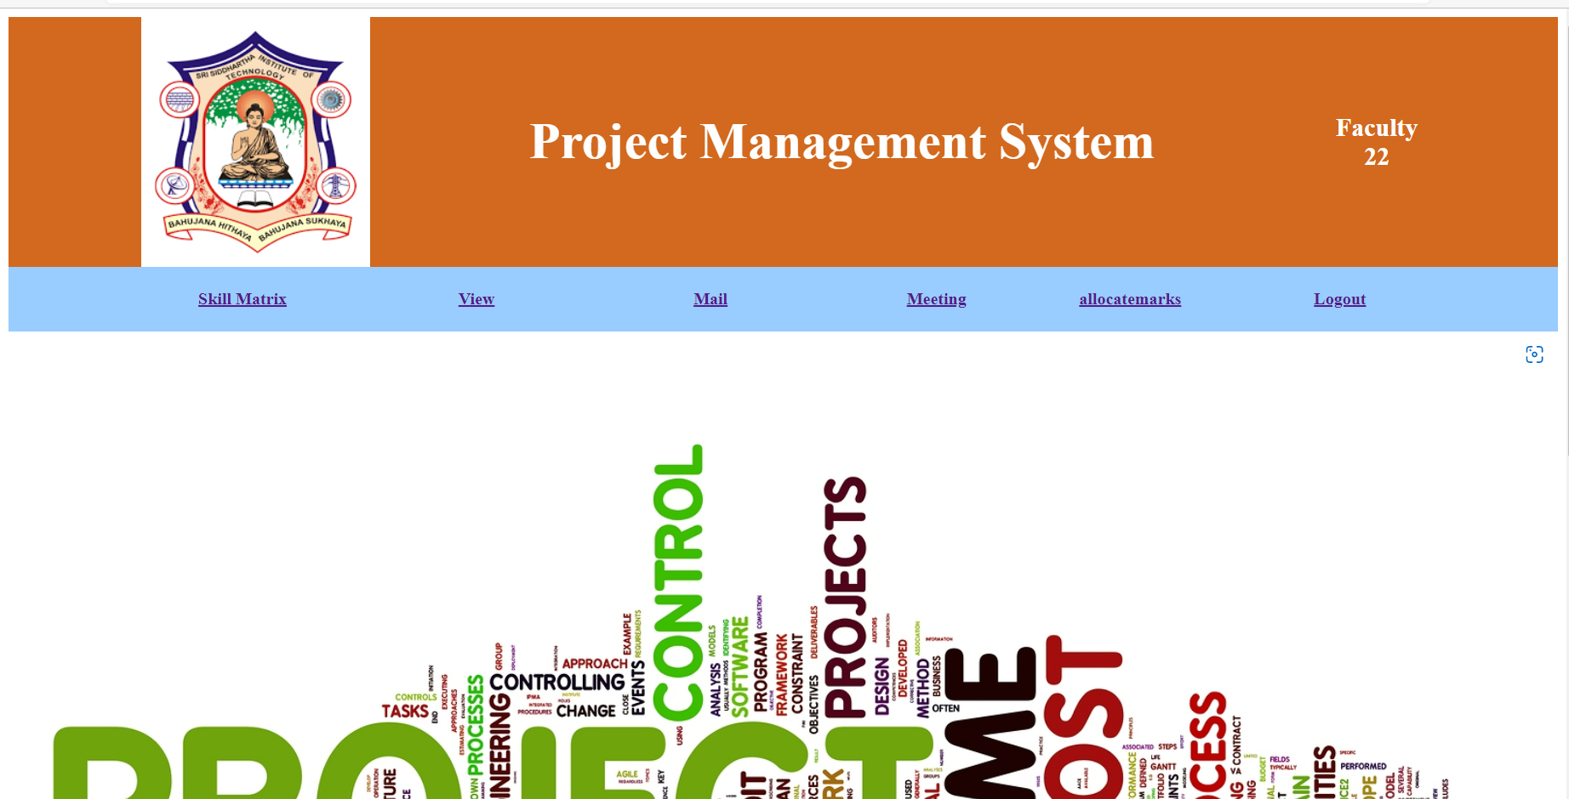
WELCOME SCREEN OF FACULTY LOGIN

Slide 15
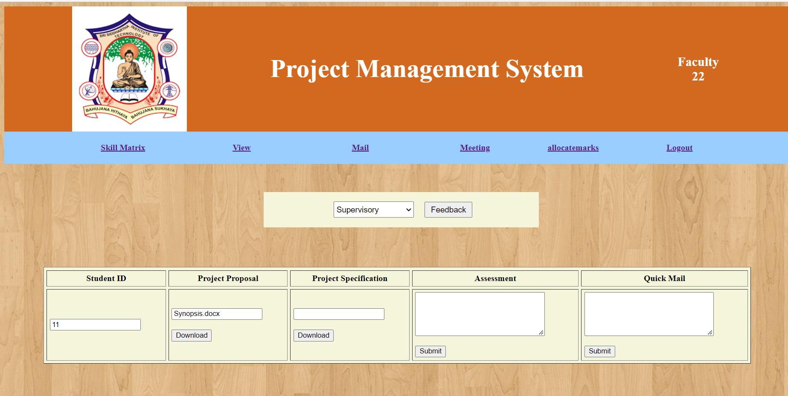
VIEW OF REPORTS

Slide 16
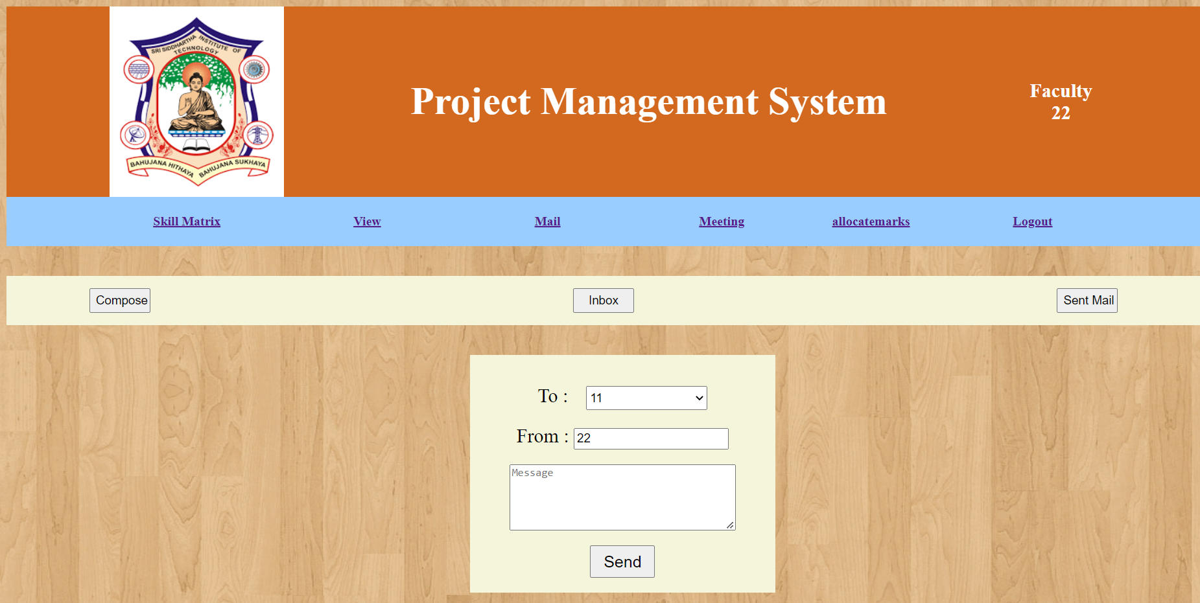
COMMUNICATION

Slide 17
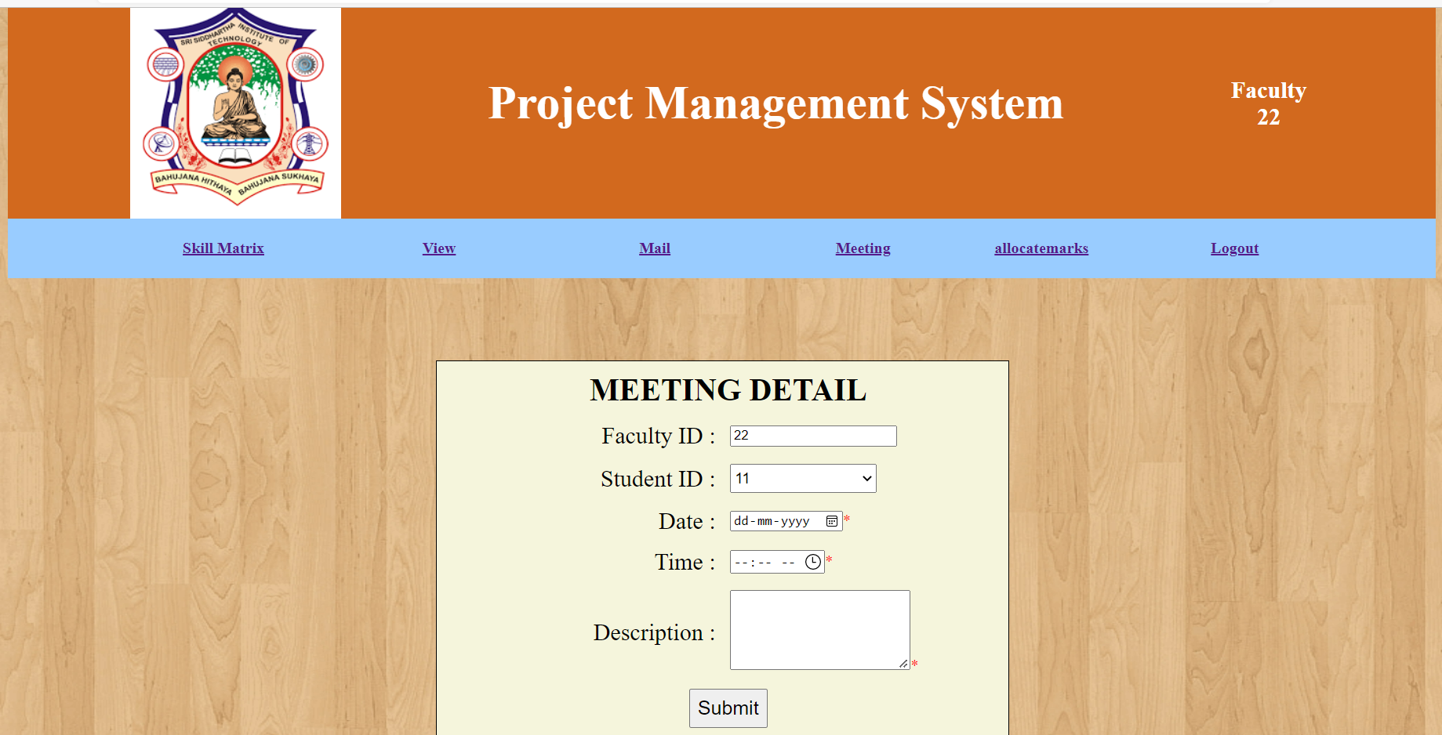
SCHEDULE MEETINGS

Slide 18
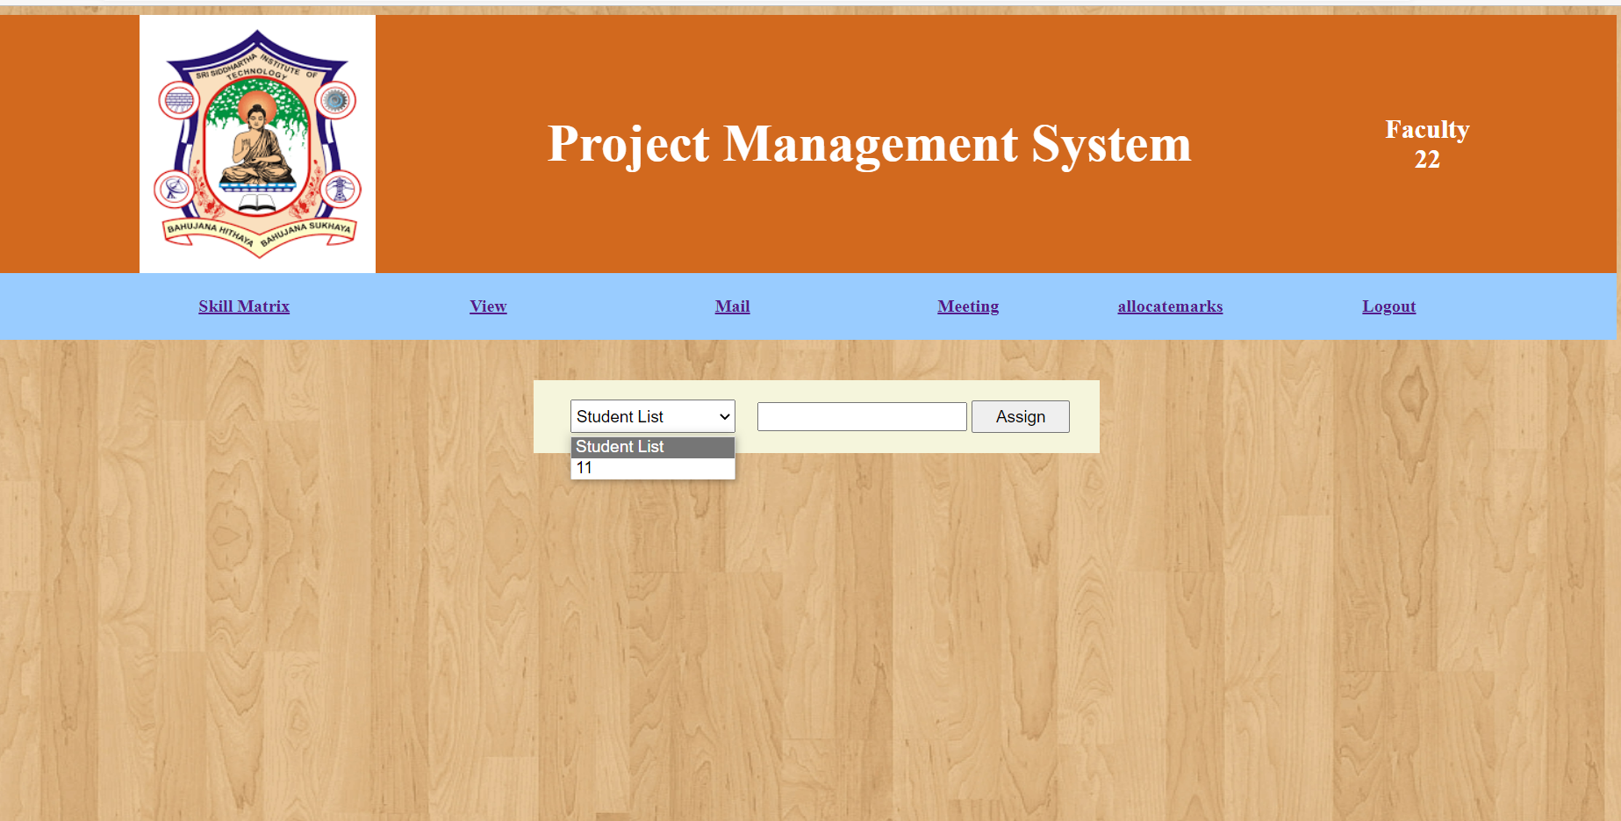
ASSIGNING MARKS

Slide 19
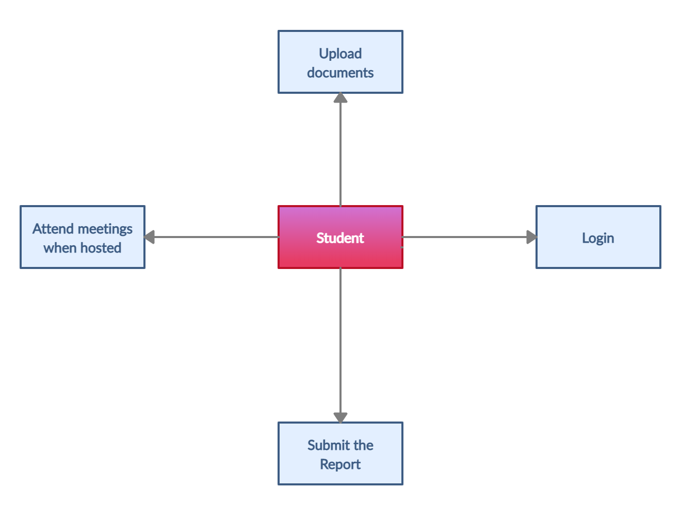
STUDENT MODULE

Slide 20
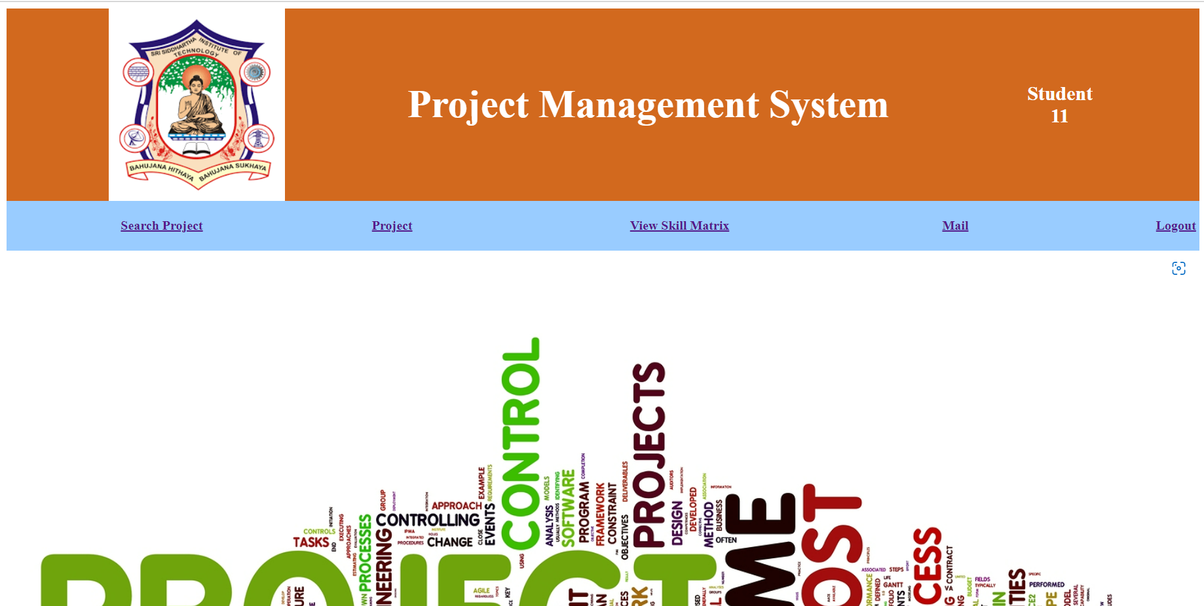
STUDENT WELCOME SCREEN

Slide 21
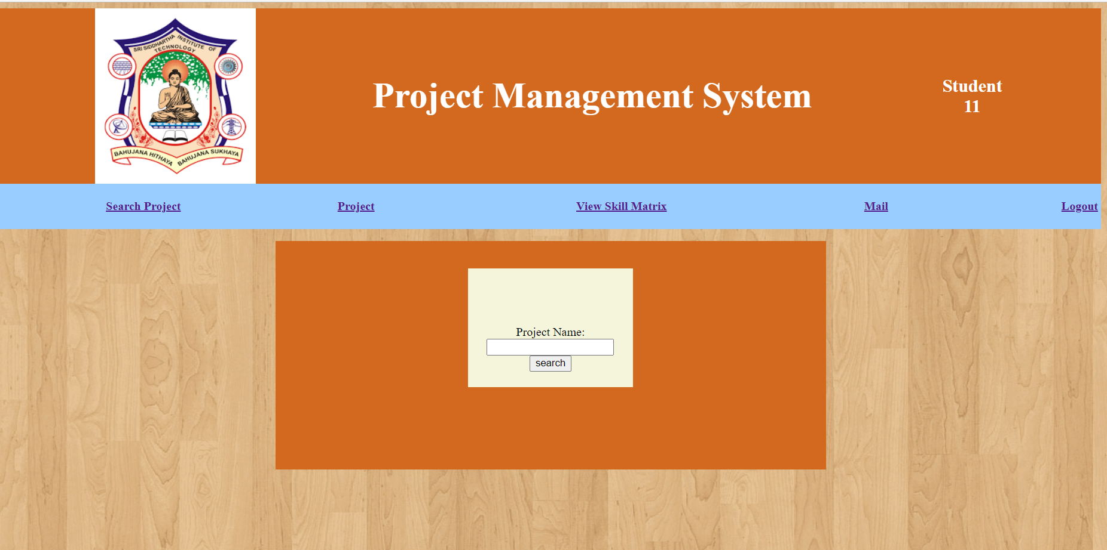
Project Duplicate DETECTION

Slide 22
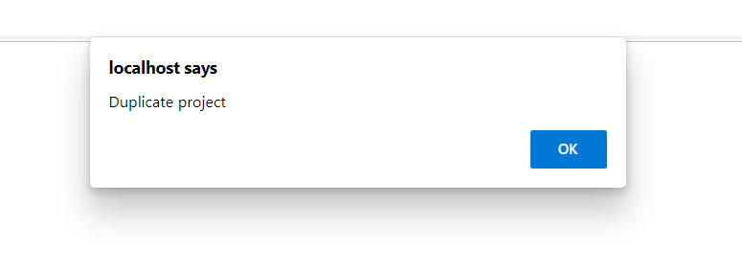
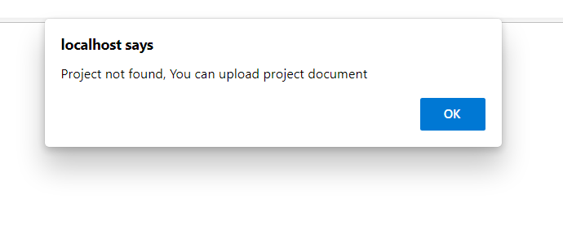
RESULTS

Slide 23
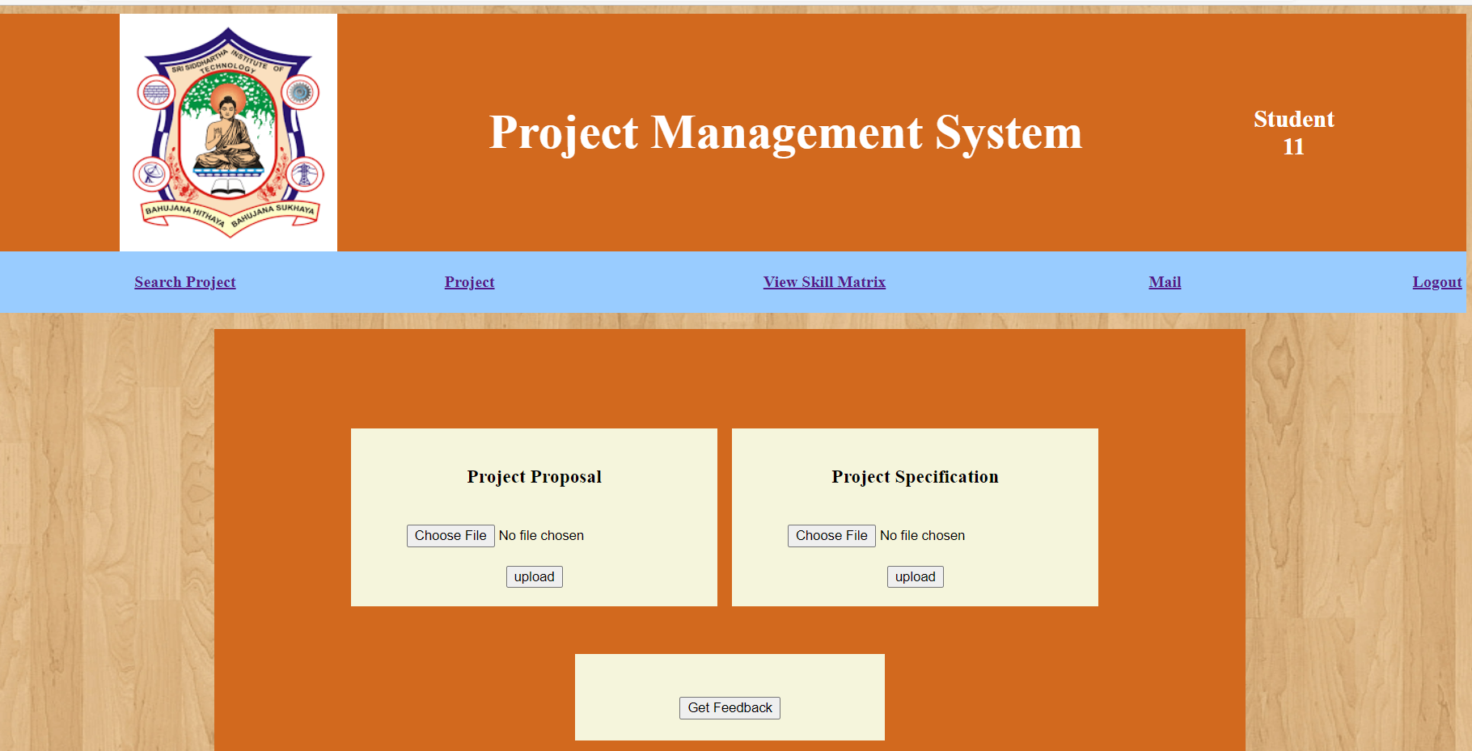
UPLOADS

Slide 24
CONCLUSION:
By the end of this project ,the project management can be done virtually. Through this the faculty, project coordinator and student can connect virtually and discuss about the project.

Slide 25
BIBLIOGRAPHY
The Web-based Student Project Management System (WSPMS), School of Science, Akanu Ibiam Federal Polytechnic Unwana.
ClockingIT is a general PMS with free licensing.
Clement and Bounds shared similar goals as WSPMS in facilitating the management of final year projects.
HKU CS Project Management System is a project management system developed in the University of Hong Kong, Department of Computer Science.
According to the Royal Institute of British Architects (as cited in Matheu, 2005).
https://creately.com/

Slide 26
THANK YOU

